Slide 1
NLP Missions & Metrics
BootCamp Technical Class [5]
Instructor: Dini

Slide 2
NLP Missions
Machine Translation
Paragraph Summarization
Recommendation
Natural Language Generation
Question Answering

Slide 3
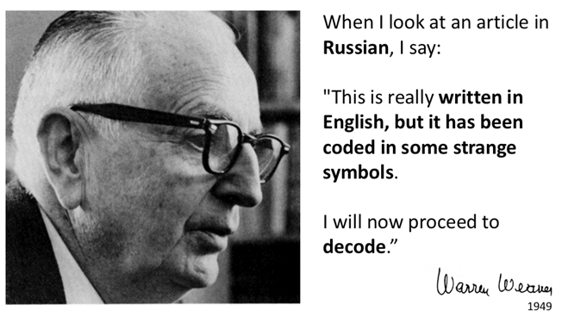
Translation
In 1949, Warren Weaver had first mentioned the possibility of using digital computers to translate documents between natural human languages in March 1947 in a letter to the cyberneticist Norbert Wiener. In the following two years, he had been urged by his colleagues at the Rockefeller Foundation to elaborate on his ideas. The result was a memorandum, entitled simply "Translation", which he wrote in July 1949 at Carlsbad, New Mexico.^{[3]}

Slide 4
Paragraph Summarization
WASHINGTON — President Trump on Monday temporarily suspended new work visas and barred hundreds of thousands of foreigners from seeking employment in the United States, part of a broad effort to limit the entry of immigrants into the country.
In a sweeping order, which will be in place at least until the end of the year, Mr. Trump blocked visas for a wide variety of jobs, including those for computer programmers and other skilled workers who enter the country under the H-1B visa, as well as those for seasonal workers in the hospitality industry, students on work-study summer programs and au pairs who arrive under other auspices.
The order also restricts the ability of American companies with global operations and international companies with U.S. branches to transfer foreign executives and other employees to the United States for months or years long stints. And it blocks the spouses of foreigners who are employed at companies in the United States.
Officials said the ban on worker visas, combined with extending restrictions on the issuance of new green cards, would keep as many as 525,000 foreign workers out of the country for the rest of the year.
Trump Suspends Visas Allowing Hundreds of Thousands of Foreigners to Work in the U.S.

Slide 5
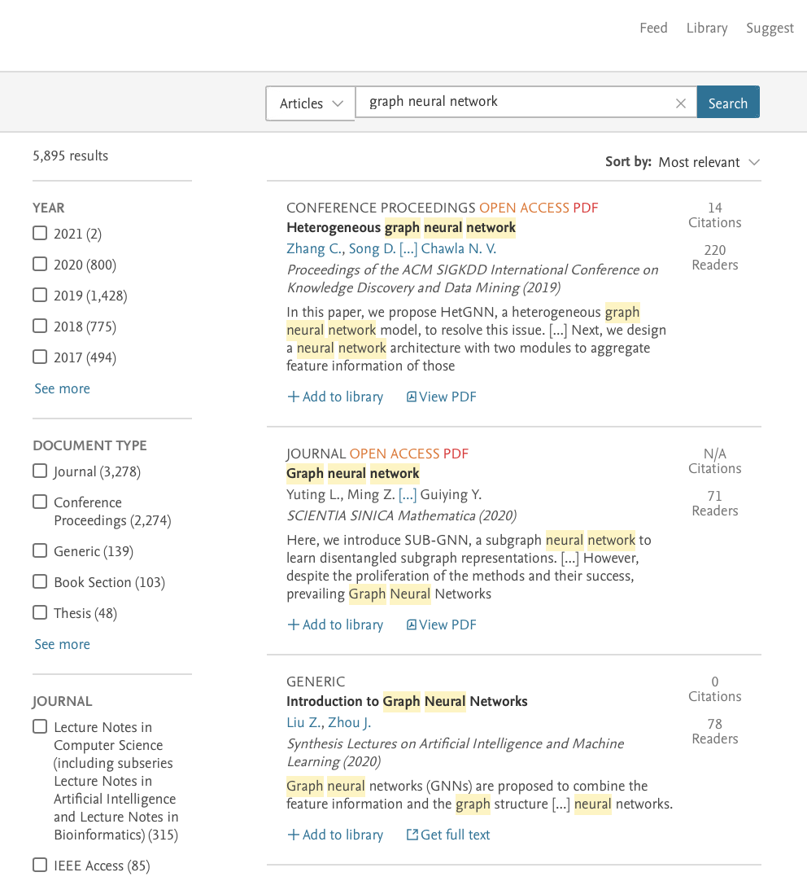
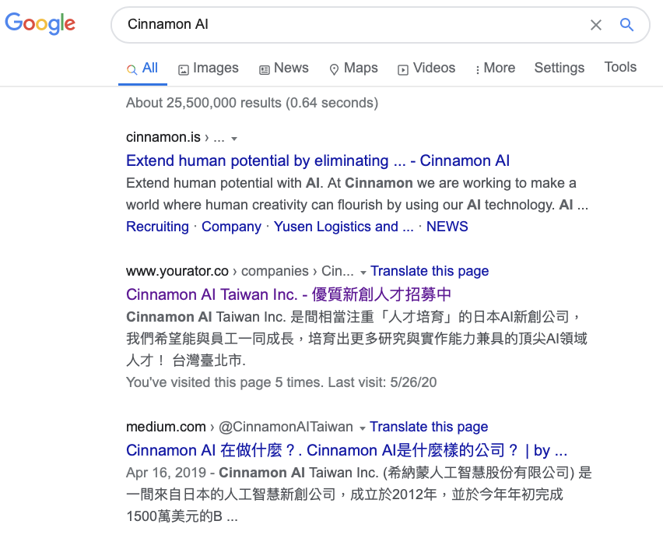
Recommendation

Slide 6

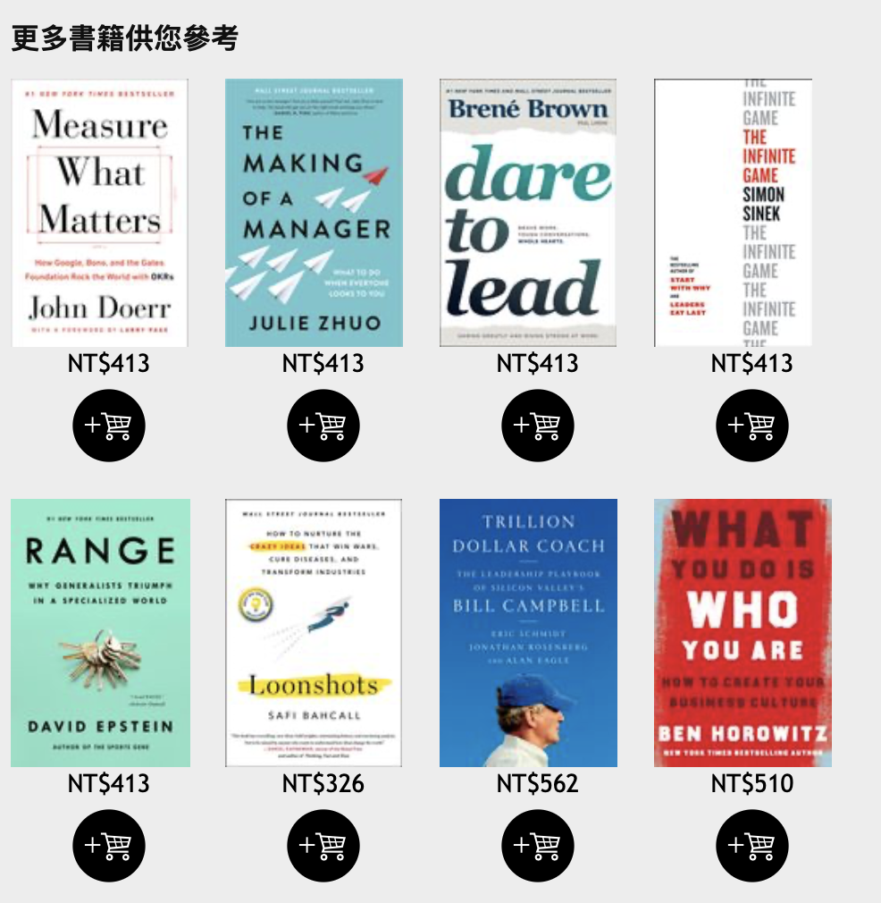

Recommendation

Slide 7
Common Metrics
F1 score
BLEU = Bilingual Evaluation Understudy
ROUGE = Recall-Oriented Understudy for Gisting Evaluation
DCG = Discounted Cumulative Gain
Normalized DCG

Slide 8
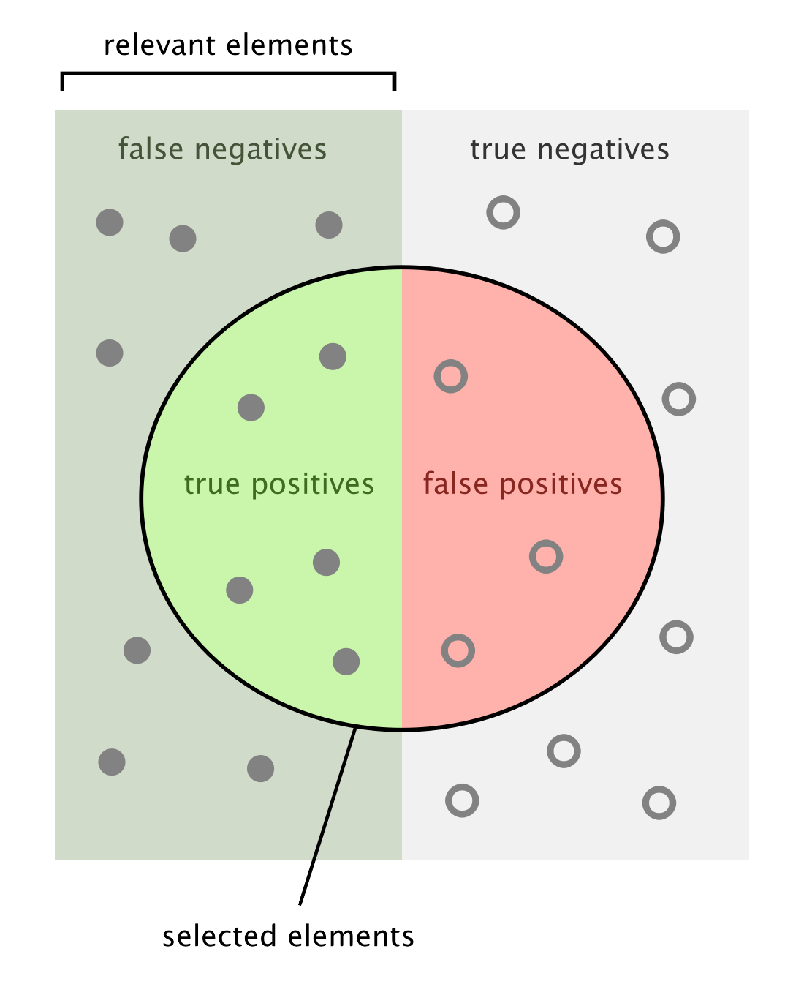
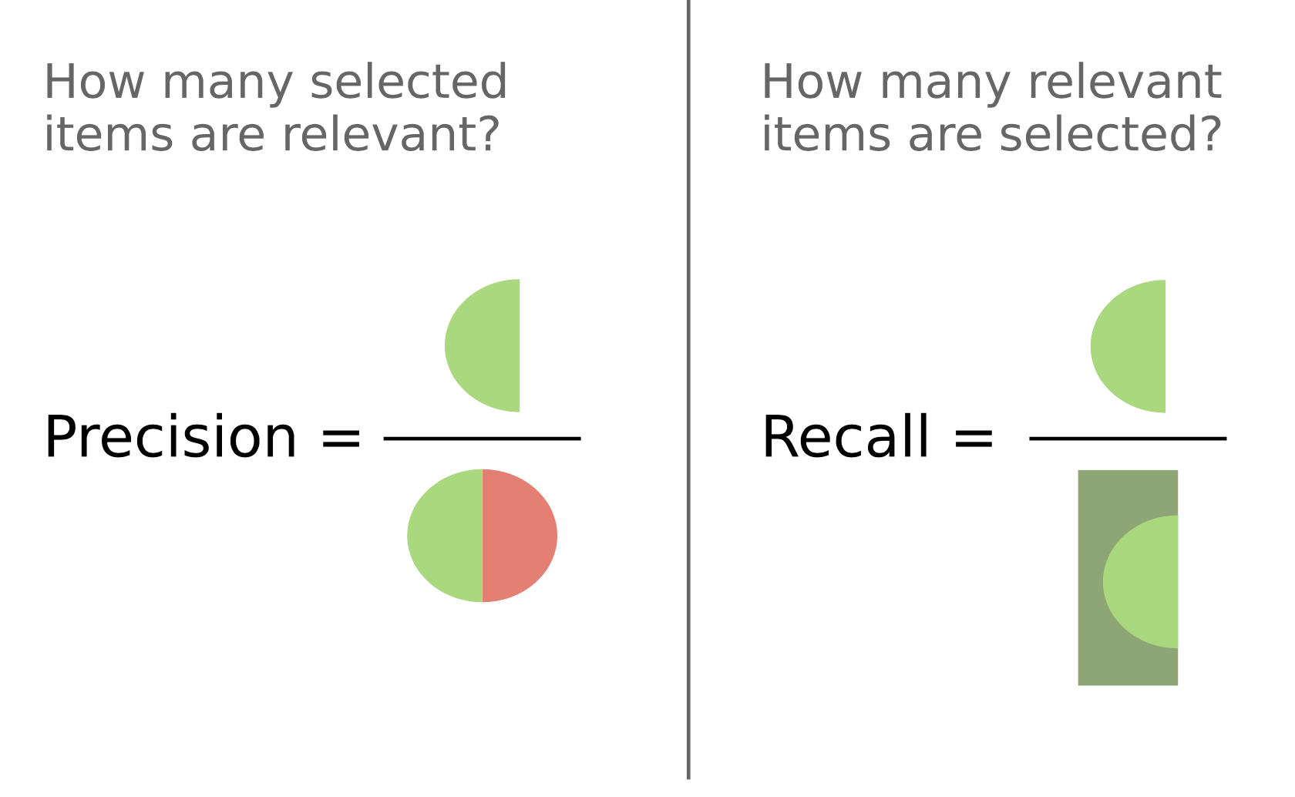
F1 score
Notes:
Image Source: Wikipedia

Slide 9

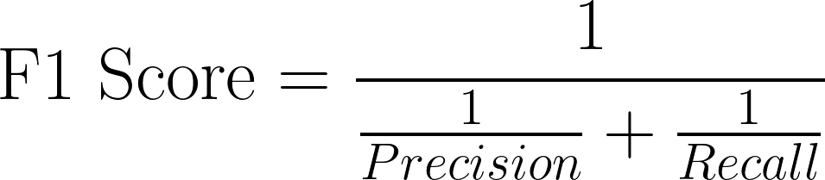

F1 score
Prediction Ground Truth | Positive | Negative
Positive | True Positive | False Negative
Negative | False Positive | True Negative

Slide 10
Measure Translation quality
Objective:
Translation quality monotonic w.r.t Metric Scores Metric function: Good Translation ⟼ Higher score
Good translation := - Preserve as much original meaning as possible.
How? Compare with references (typically human-produced summaries.) Evaluating similarity: {Machined Inferenced translation, reference translation(s)} → Similarity Score

Slide 11
Measure Translation - BLEU
Bilingual Evaluation Understudy
Comparing a candidate translation against multiple reference translations.
Core: counting matches of n-grams in candidate and reference translation(s).
Unique [Unigram / Bigram] Count
Using modified precision for ngram
geometric average of the modified n-gram precisions, pn, using n-grams up to length N and positive weights wn summing to one.
Notes:
BLEU Paper: https://www.aclweb.org/anthology/P02-1040.pdf
Blog: https://www.cl.uni-heidelberg.de/courses/ss15/smt/scribe8.pdf
https://leimao.github.io/blog/BLEU-Score/
https://towardsdatascience.com/bleu-bilingual-evaluation-understudy-2b4eab9bcfd1

Slide 12
Measure Translation - BLEU
French input: Le chien fait du jogging avec bonheur dans le parc
Translated Candidate: Happy dog and park dog park park
Reference 1: The dog is happy in the park Reference 2: The dog is jogging in the park happy
Similarity = ?
Notes:
BLEU Paper: https://www.aclweb.org/anthology/P02-1040.pdf
Blog: https://www.cl.uni-heidelberg.de/courses/ss15/smt/scribe8.pdf

Slide 13
Measure Translation - BLEU
park | 3 | T
dog | 2 | T
happy | 1 | T
walk | 1 | F
and | 1 | T
Translated Candidate: Happy dog and park dog walk park park
Reference 1: The dog is happy in the park
Unigram precision = ⅞
p.s. Same process can be applied to Bigram, Trigram, Quadgram…. precision.
Unique Unigram Count Sum = 8
Notes:
BLEU Paper: https://www.aclweb.org/anthology/P02-1040.pdf
Blog: https://www.cl.uni-heidelberg.de/courses/ss15/smt/scribe8.pdf

Slide 14
Measure Translation - BLEU
Translated Candidate: is is is is is is is
Reference 1: The dog is happy in the park
Unigram precision = 7/7 = 100%
Something’s weird!
is * 7
is | 7 | T
Unique Unigram Count
Notes:
BLEU Paper: https://www.aclweb.org/anthology/P02-1040.pdf

Slide 15
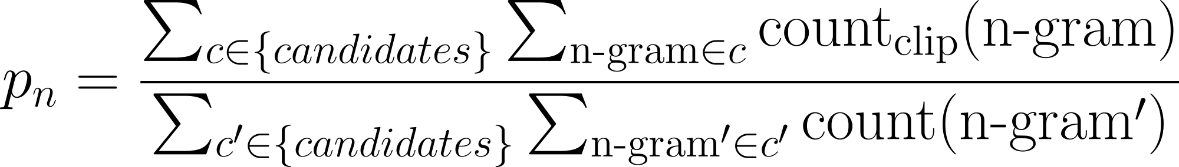
Measure Translation - BLEU
Modifying
Given number n, modify n-gram precisions (p_{n}):
All candidate sentences are filtered with corpus.
Cliping: Clip the total number of matches of a candidate n-gram by the maximal reference match.
Divide by the not clipped.
Notes:
BLEU Paper: https://www.aclweb.org/anthology/P02-1040.pdf

Slide 16
Measure Translation - BLEU
2
Set “maximal reference match” = 2 Do Clipping.
Translated Candidate: is is is is is is is
Reference 1: The dog is happy in the park
Unigram precision = 2/7 = 28.5%
Seems more reasonable!
is | 7 | T
Unique Unigram Count
Notes:
BLEU Paper: https://www.aclweb.org/anthology/P02-1040.pdf

Slide 17
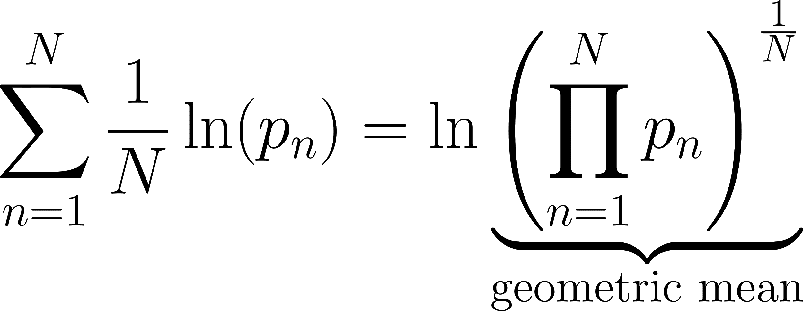
Measure Translation - BLEU
Combining modified n-gram precisions:
Ln: natural log.
Notes:
BLEU Paper: https://www.aclweb.org/anthology/P02-1040.pdf

Slide 18
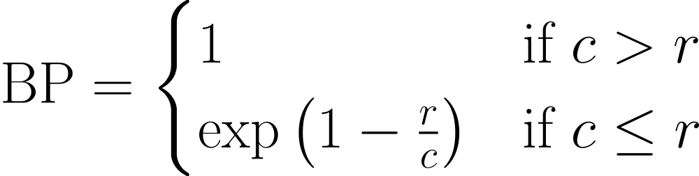
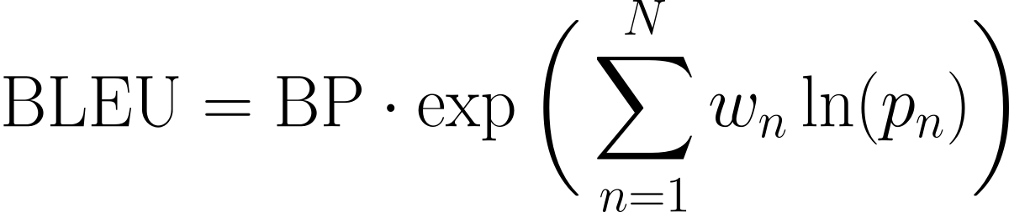
Measure Translation - BLEU
Sentence Brevity Penalty (BP)
c: length of the candidate translation r: effective reference corpus length
BLEU metric
p_{n}: n-gram precision w_{n}: positive weights, sum=1
p.s. ranking behavior is more apparent in the log domain, e.g. log(BLEU)
Notes:
BLEU Paper: https://www.aclweb.org/anthology/P02-1040.pdf

Slide 19
Measure Summarization quality
Objective:
Summarization quality monotonic w.r.t Metric Scores Metric function: Good Summarization ⟼ Higher Score
Good summarization := - Preserve as much original meaning as possible. - Avoid unnecessary words.
How? Compare with references (typically human-produced summaries.) Evaluating similarity: {Machined Inferenced summary, reference summary(ies)} → Similarity Score

Slide 20
Measuring Summarization - ROUGE
Recall-Oriented Understudy for Gisting Evaluation
ROUGE-N: Evaluating Reference summaries.
ROUGE-L: Sentence level Structure Similarity & Longest co-occurring in Sequence n-grams.
We care more about Recall!
Notes:
Package Reference:
V1: https://www.aclweb.org/anthology/W04-1013.pdf
V2: https://www.ideals.illinois.edu/bitstream/handle/2142/99160/rouge-2.0.pdf
Short intro:
http://www.ccs.neu.edu/home/vip/teach/DMcourse/5_topicmodel_summ/notes_slides/What-is-ROUGE.pdf
https://sagorbrur.github.io/rouge.html
https://en.wikipedia.org/wiki/ROUGE_(metric)

Slide 21
Measuring Summarization - ROUGE-N
the | 2 | F
dog | 1 | T
is | 1 | F
happy | 1 | T
in | 1 | F
park | 1 | T
N stands for N-grams, ROUGE-1 Example:
Summary Candidate: Happy dog and park dog walk park park
Reference 1: The dog is happy in the park
Unigram recall = 3/7
p.s. Same process can be applied to Bigram, Trigram, Quadgram…. precision.

Slide 22
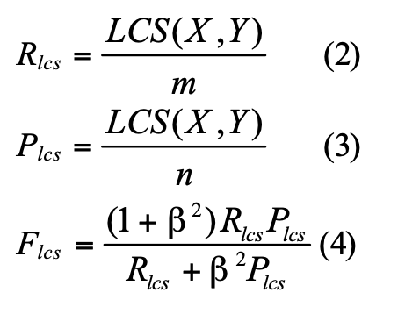
Measuring Summarization - ROUGE-L
“L” stands for Longest common subsequence problem (LSC)
LCS score of the union longest common subsequence between reference sentence Xand candidate summary Y.
Recall
Precision
LCS-based F-measure = ROUGE-L
Beta chosen & fixed.
Notes:
https://www.aclweb.org/anthology/W04-1013.pdf

Slide 23
Measure Ranking quality
Objective:
Documents ranking monotonic w.r.t Documents relevance Aka: Highly relevant documents → Higher rank
Usefulness: Highly relevant documents > marginally relevant documents >>> non-relevant documents.
TODO: Recall / Precision

Slide 24

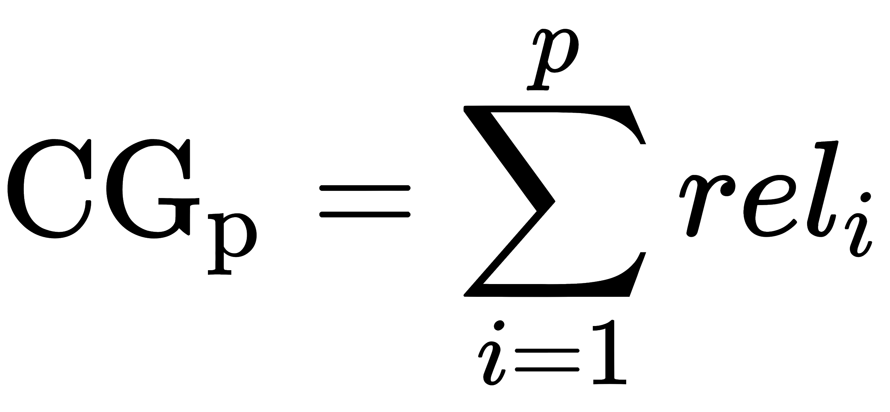
Measure Ranking quality - CG
Cumulative Gain (without discounting) Sum of the graded relevance values for the search result list.
Graded relevance at position i.
Cumulative Gain up to position p.
(Can be provided by users.)

Slide 25
Measure Ranking quality - CG
Ranking list | Relevance Score
Donald Trump | 10
Barack Obama | 9
Margaret Thatcher | -10
Franklin D. Roosevelt | 9
Cumulative Gain (without discounting)
(Can be provided by users.)
Query = “US president”

Slide 26
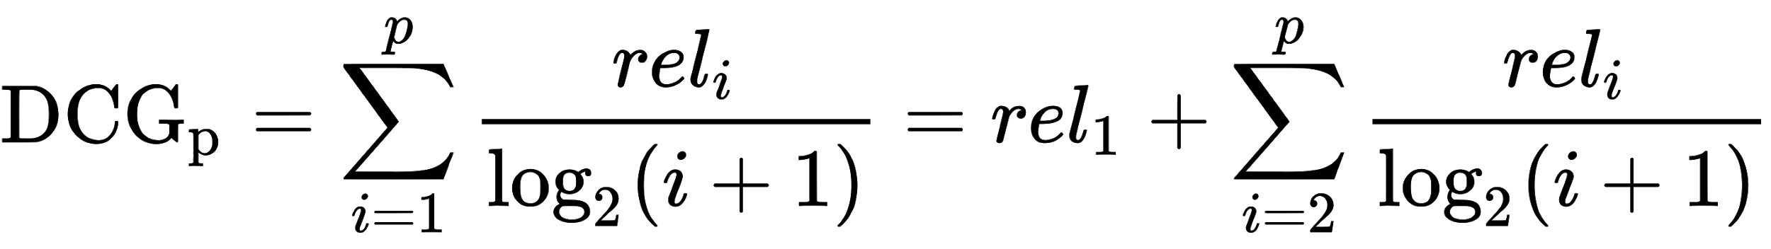
Measure Ranking quality - DCG
Discounted Cumulative Gain
Why discounting? Evaluate the correlation!
[Document relevance ↔︎ Document rank] The lower the ranking, the larger the discount.

Slide 27
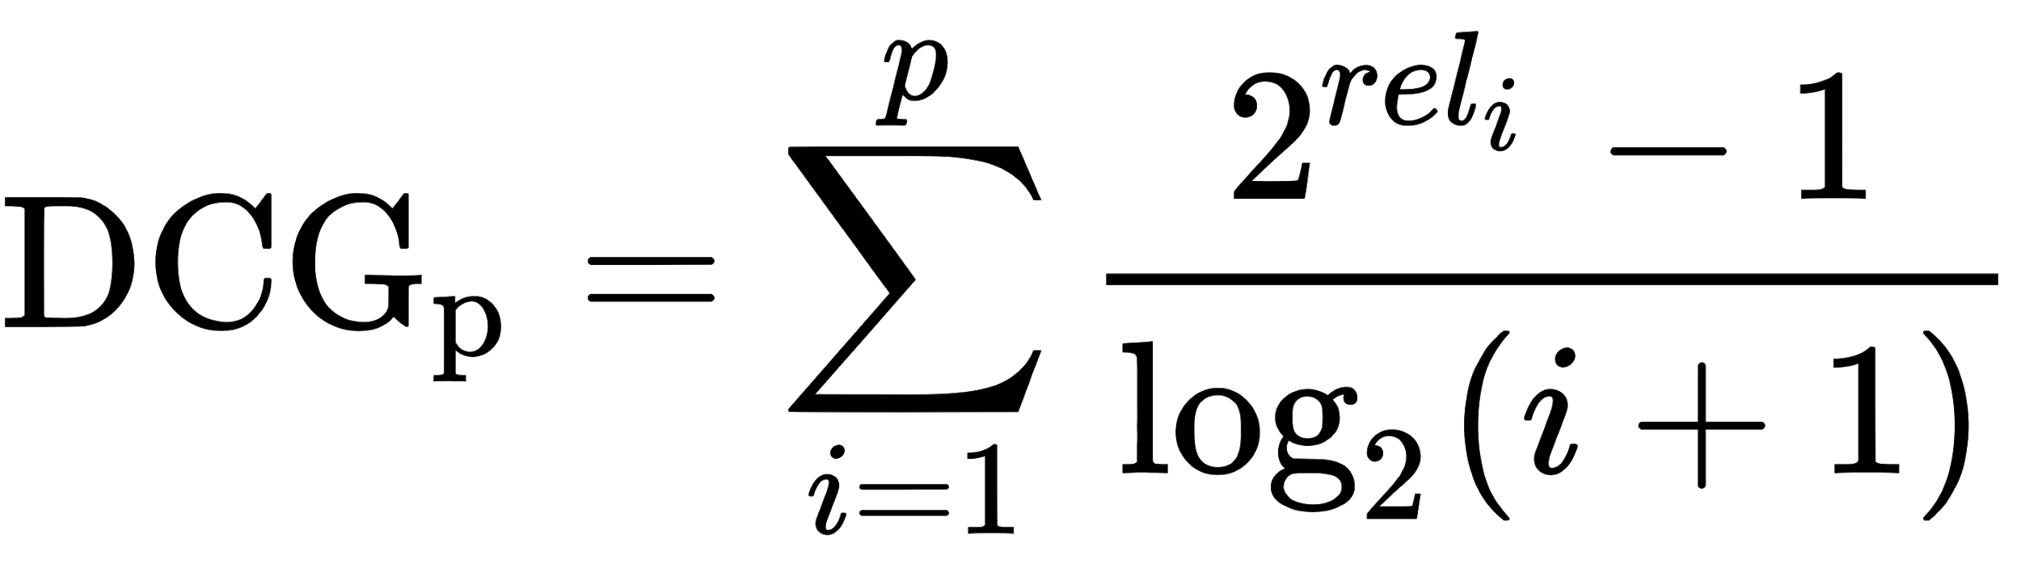
Measure Ranking quality - DCG
Discounted Cumulative Gain
Another alternative.
Those 2 forms of DCG should be the same when the relevance are binary. E.g. when

Slide 28
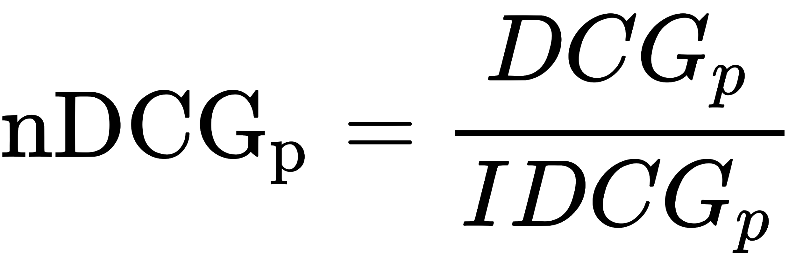
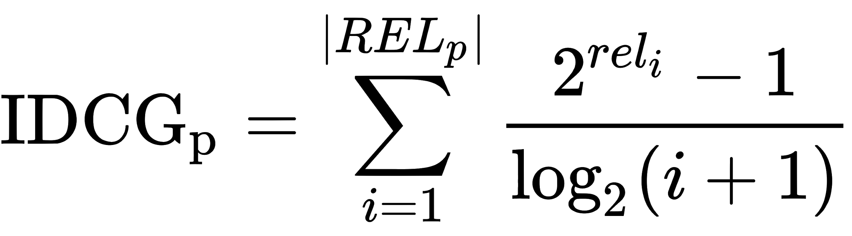
Measure Ranking quality - Normalized DCG
Normalized Discounted Cumulative Gain
Why Normalizing?
Different searching query effects the length of result lists. We want to comparing a search engine's performance cross queries. ⇒ Normalizing score across queries.
Take this as the DCG calculated from a perfect ranking sequence!
Notes:
The ground truth labeling issue.

Slide 29
Hands-on list
Normalized DCG

